Slide 1
The Statiscal Reality of the NBA Draft
By: Kyle Salgado-Gouker

Slide 2

Should an NBA team “tank” to secure a player who will contribute more future wins?
NOTE:
To change images on this slide, select a picture and delete it. Then click the Insert Picture icon
in the placeholder to insert your own image.

Slide 3

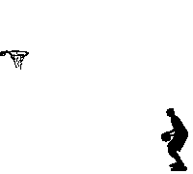
Analysis of 5 Variables
1 - Impact
2 - Season Performance
3 - Draft Power
4 - Weighted Win Cost
5 - Estimated Draft Pick Value
VARIABLES

Slide 4
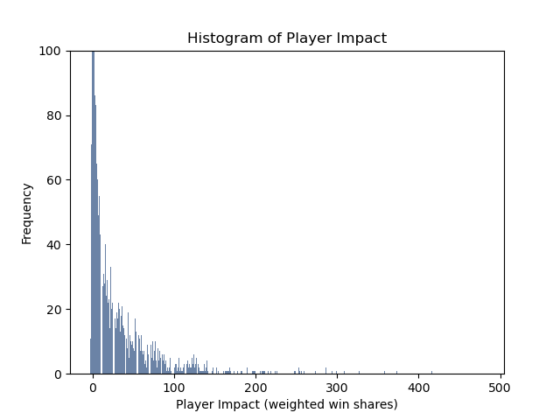

Variable #1: Impact
How much a player contributes in the season, weighted strongly to playoff contribution.
Outliers include players who have negative player impact and players who have extraordinary impact, such as Kareem Abdul-Jabaar, Lebron James, Kobe Bryant, and Michael Jordan.

Slide 5
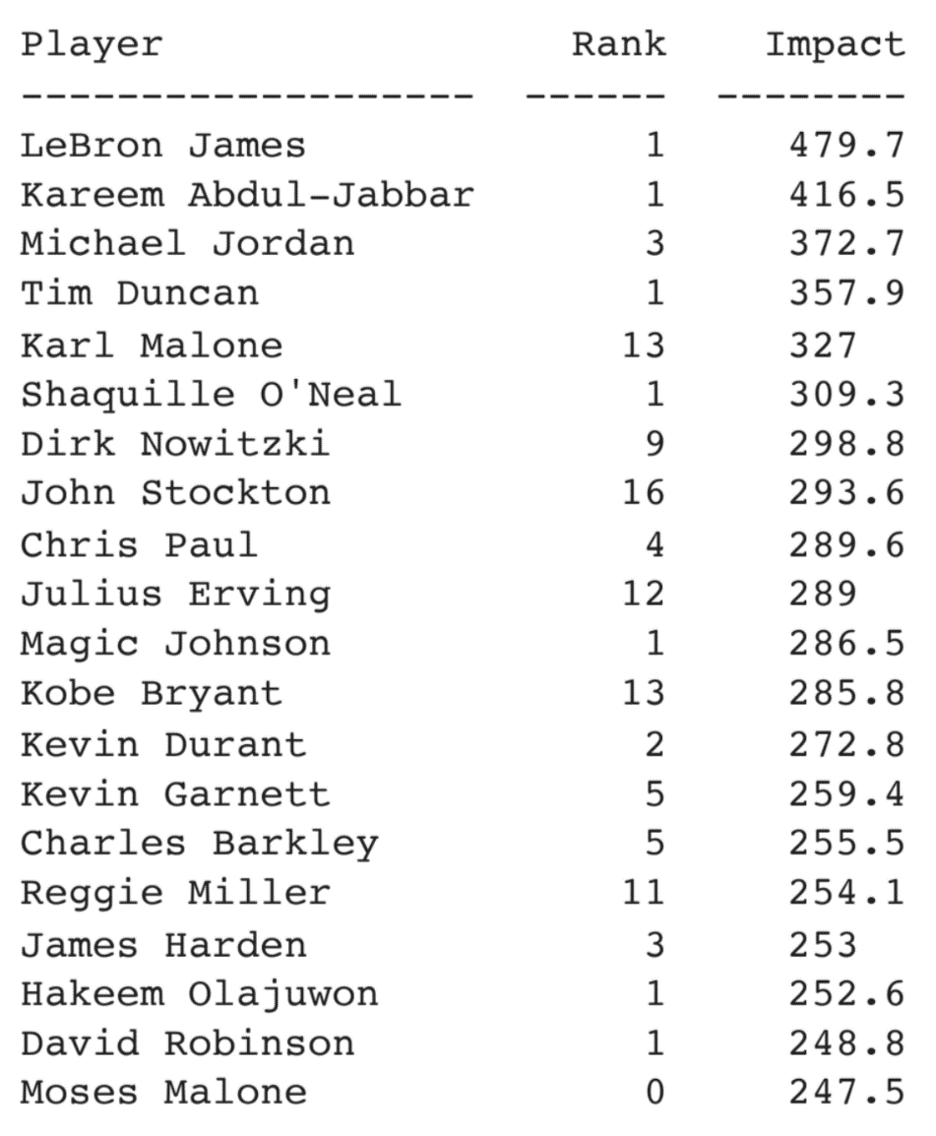
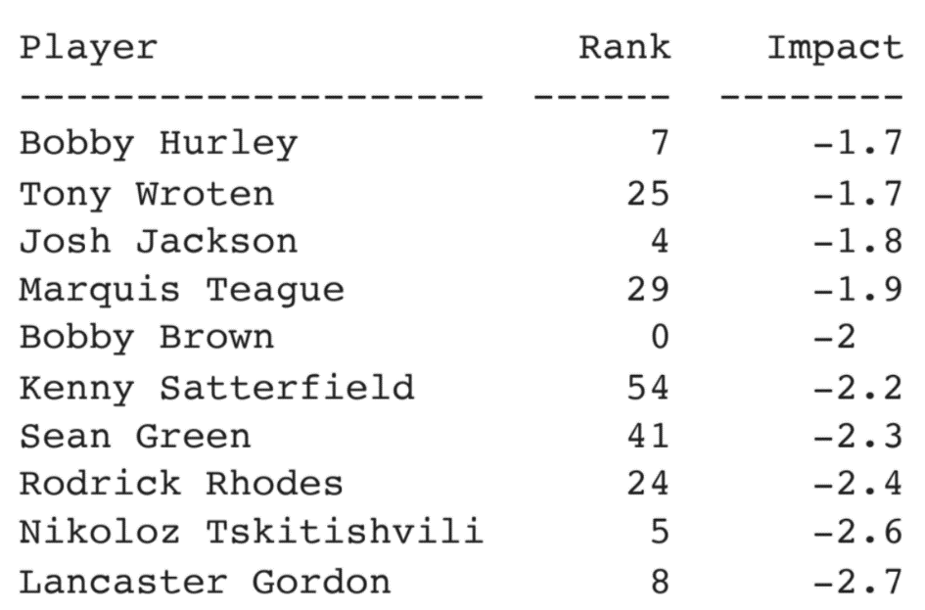
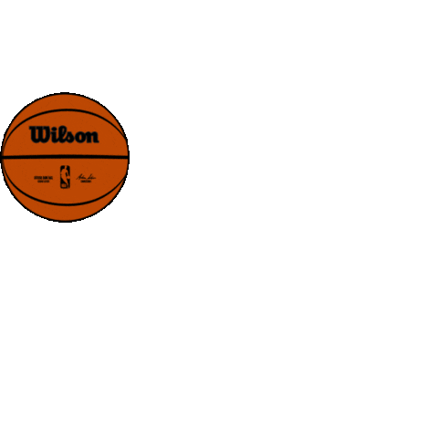
Variable #1: Impact
Top Players By Impact
Worst Players By Impact

Slide 6
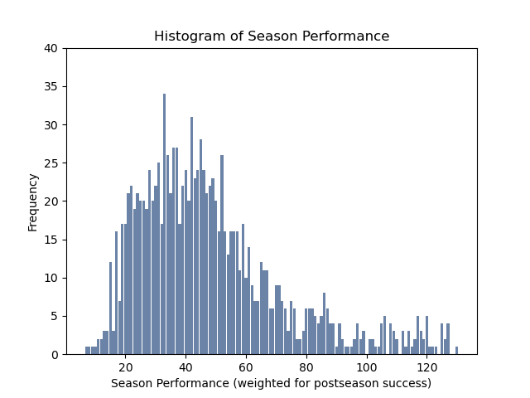

Variable #2: Season Performance
Shows how well a team played, weighted strongly to playoff contribution.
This histogram shows the performance of every NBA team for every season from 1981 through 2023. It appears to be a normal distribution with a long right skewing which include the most successful teams.

Slide 7
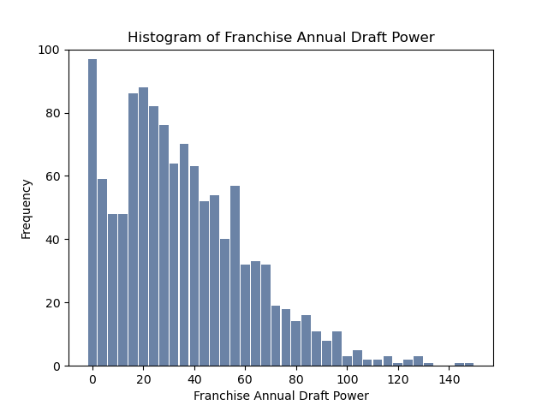

Variable #3: Draft Power
Sum of draft picks a team receives measured by the sum of their average win shares in weighted formula
→ Annual draft power is a measure of a franchise’s power in the draft measured in the potential wins that can be achieved by their sum of picks measured in median player impact, a combination of regular season wins and playoff wins.
https://www.google.com/url?sa=i&url=https%3A%2F%2Ftenor.com%2Fsearch%2Fnba-gifs&psig=AOvVaw0Hwt6KXQKRSjuW5f25sfrw&ust=1685912656101000&source=images&cd=vfe&ved=0CBAQjRxqFwoTCNDJiJqAqP8CFQAAAAAdAAAAABBa

Slide 8
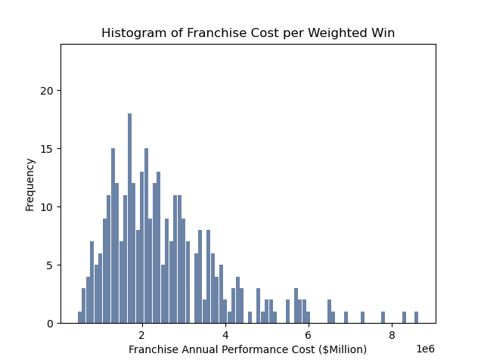
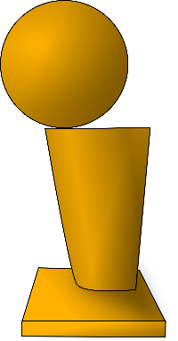

Variable #4: Weighted Win Cost
Cost each team plays per win per season, weighted strongly for postseason wins.
→ When restricted to seasons since the last NBA lockout of 2011-2012, it is evident that the cost of a weighted win share, performance cost, has increased.

Slide 9
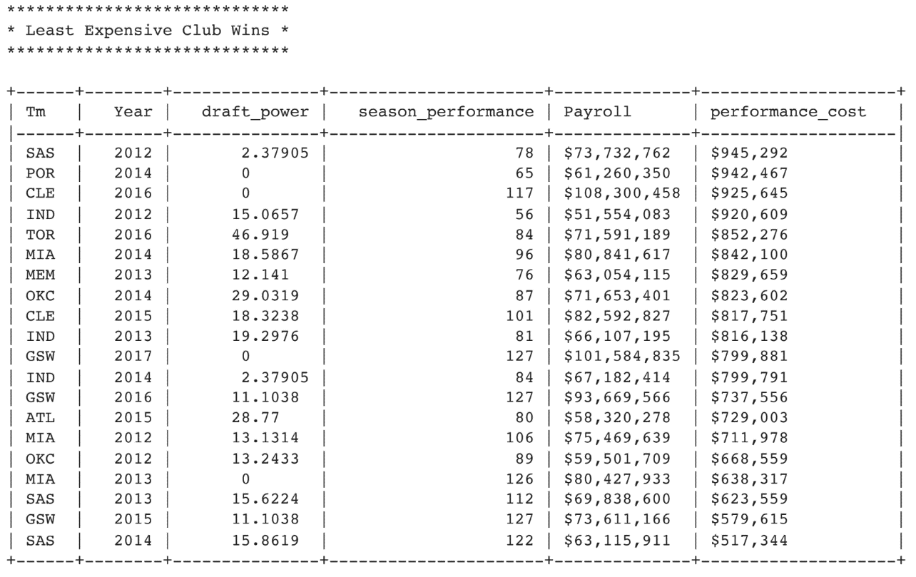
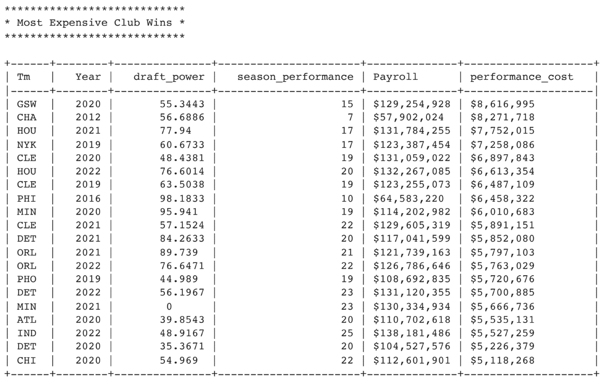
Variable #4: Weighted Win Cost
Most Expensive Club Wins
Least Expensive Club Wins
Performance Cost is more dependent on the team’s performance than payroll. The most expensive club wins tend to be from teams with a low season performance, while the least expensive come from teams with a higher performance.
Clearly, a large payroll expense is no guarantee of NBA franchise success.

Slide 10
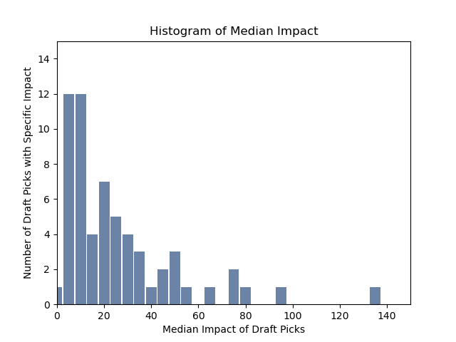

Variable #5: Estimated Draft Pick Value
Weighted player impact of average pick.
→ In the graph, it is apparent that only a few draft picks have enormous consequences. Most draft picks cluster around 5-25 Median Impact over the career of a player.

Slide 11

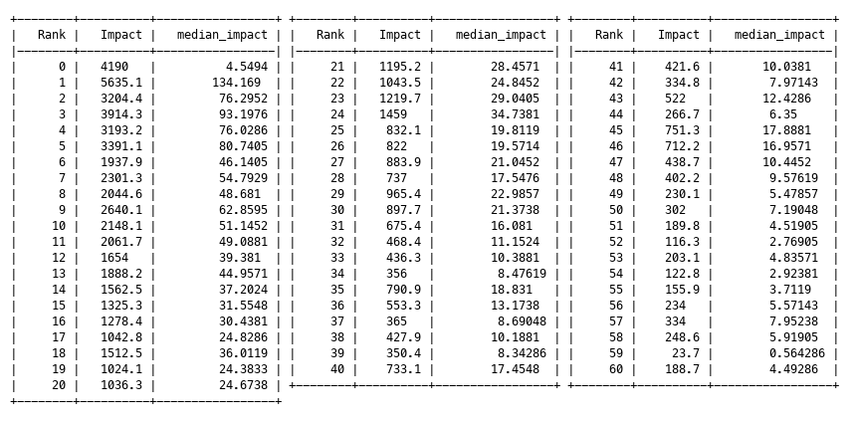
Variable #5: Estimated Draft Pick Value
Median Draft Rank Impact
This output shows the median impact of draft picks from 1-60 (the NBA 2-Round Draft layout post 1989) as well as undrafted players (rank 0).

Slide 12

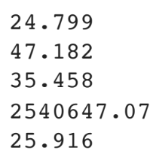
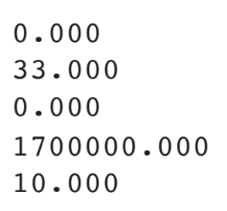
Mean & Mode of 5 Variables
Mean of Data Frames
Mode of Data Frames
Weighted Player Impact
Season Performance
Draft Power
Performance Cost
Median Impact
Weighted Player Impact
Season Performance
Draft Power
Performance Cost
Median Impact

Slide 13
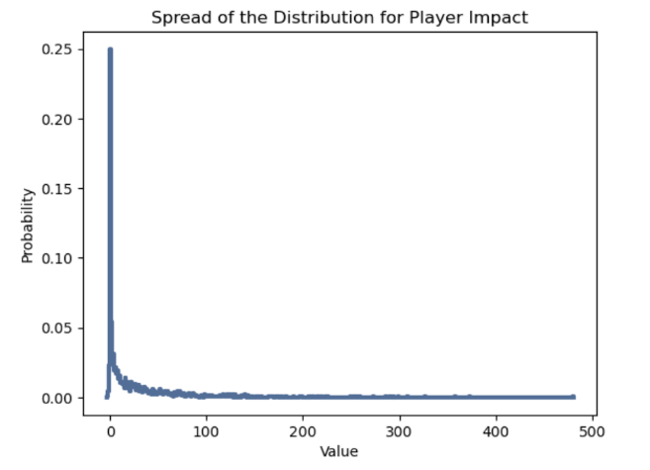
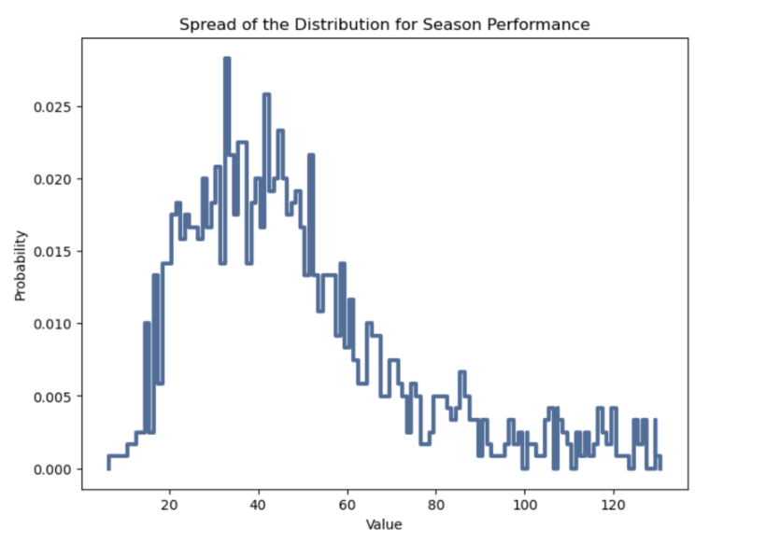
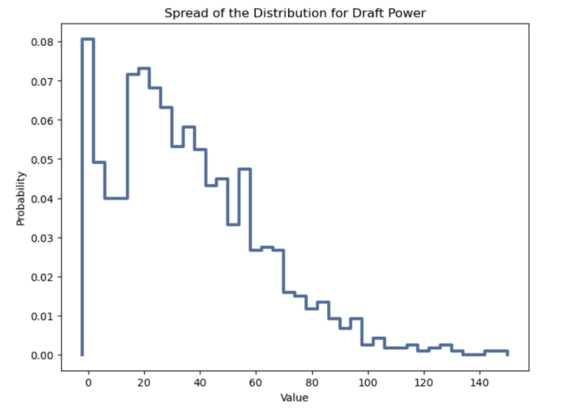

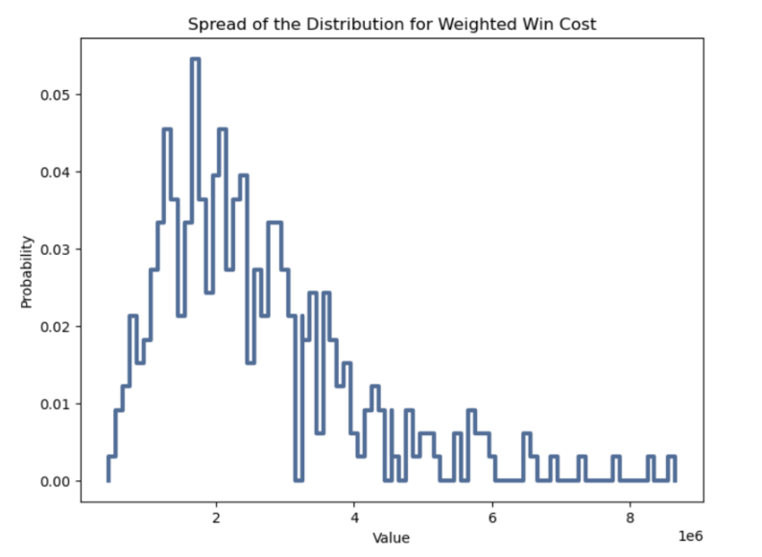
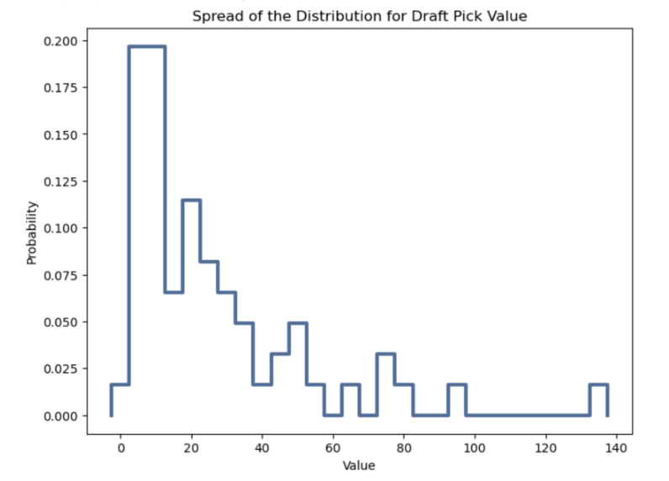
Spread of 5 Variables
Player Impact
Season Performance
Draft Power
Weighted Win Cost
Draft Pick Value

Slide 14
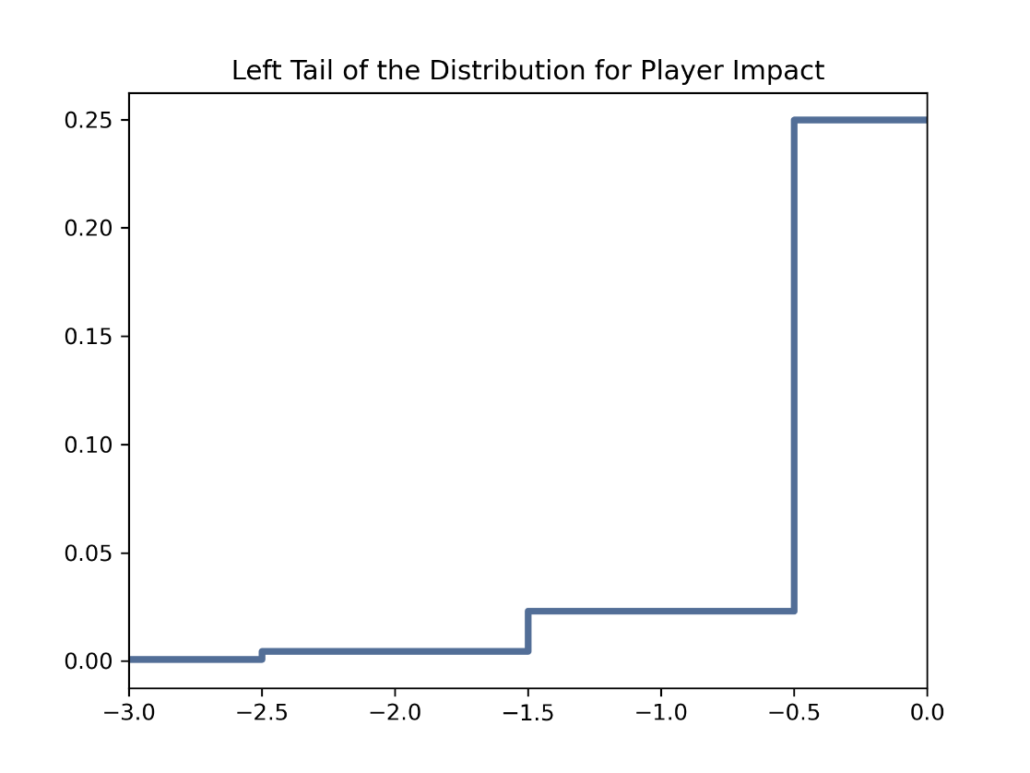
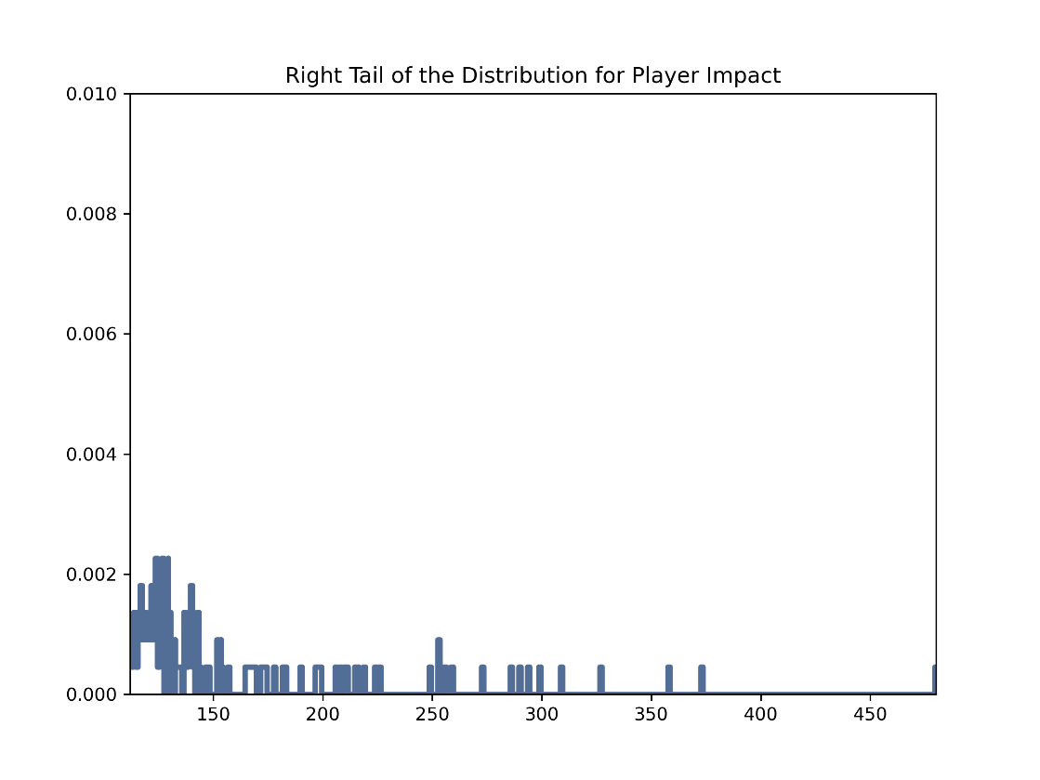

Tails of Variable #1: Impact
→ The left tail shows the small number of players who had a negative impact on their teams over the career.
→ The right tail shows the most extraordinary players. The highest ranked player measured in 'Impact' is LeBron James, the rightmost line around 480.

Slide 15





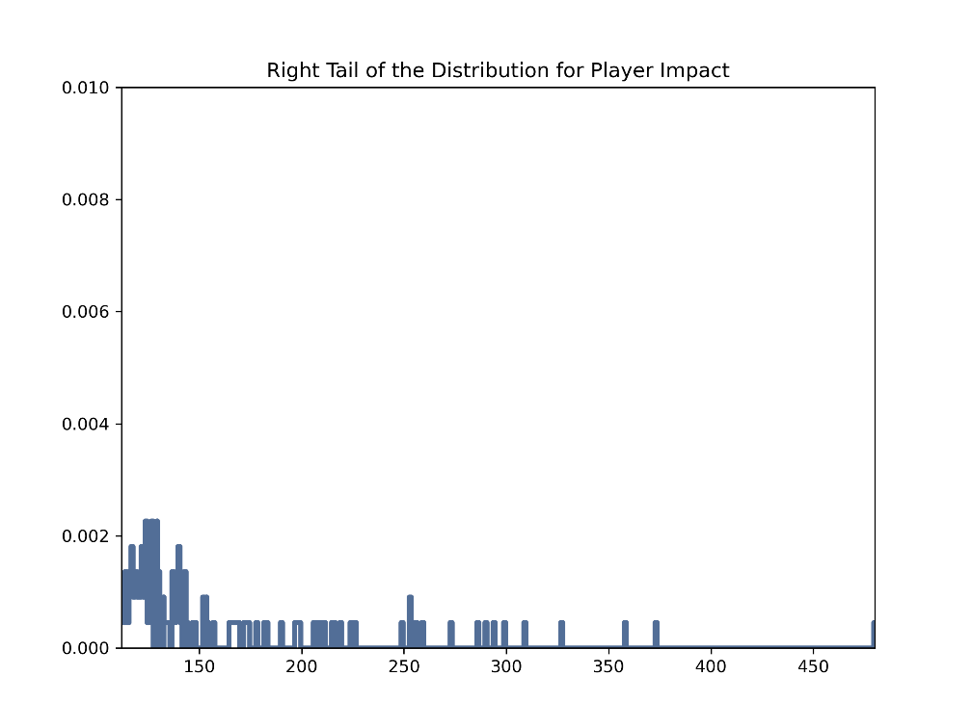



Tails of Variable #2: Season Perfomance
→ The right tail includes such teams as the 2012-13 Miami Heat, the 1995-96 Chicago Bulls, the 2015-16 Golden State Warriors, and the 2008-09 LA Lakers.
→ The left tail shows the worst teams, such as the 2011-12 Charlotte Bobcats, the 2015-2016 Philadelphia 76ers, and the 2009-10 New Jersey Nets.

Slide 16
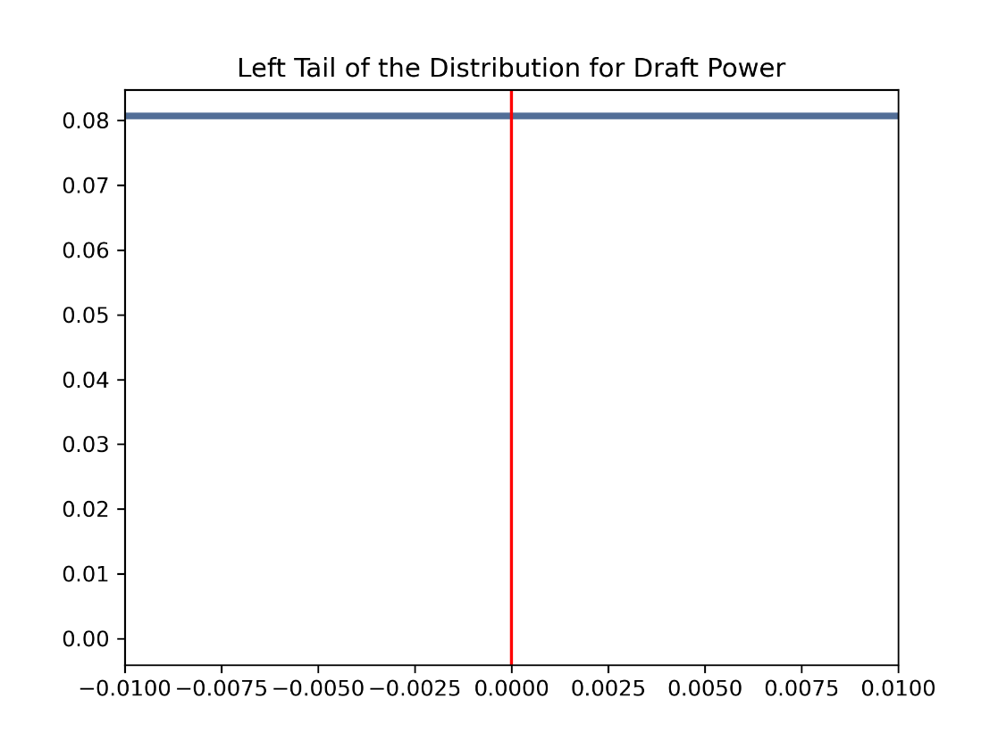
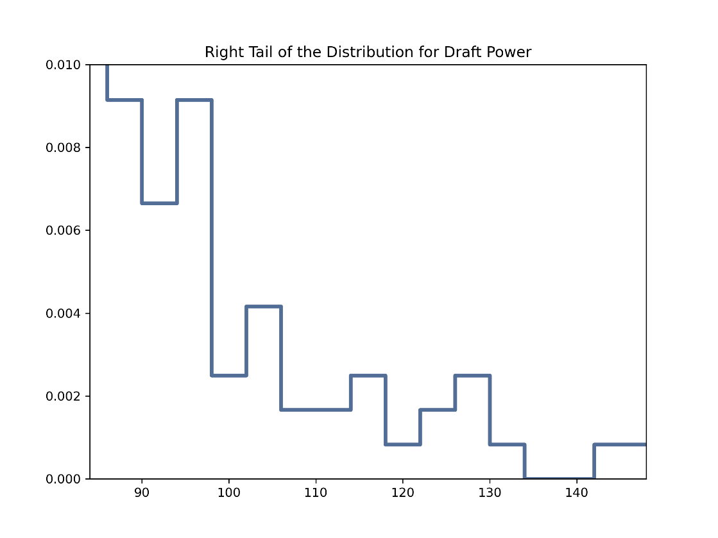

Tails of Variable #3: Draft Power
→ There are a number of teams every season who have no draft pick, usually because they have been traded. There are so many that the entire lower bound is larger than the specified tail, so I drew a single line at 0.
→ For the right tail, there are teams who have accumulated picks. These are more unusual, because the first few picks are highly coveted.
https://media0.giphy.com/media/Ma0lUxnBMe54222PJo/giphy.gif?cid=6c09b952gzf2kxsaaqg7wss4kdjm50ntsa71uw8f54i9x4d5&ep=v1_stickers_related&rid=giphy.gif&ct=s

Slide 17
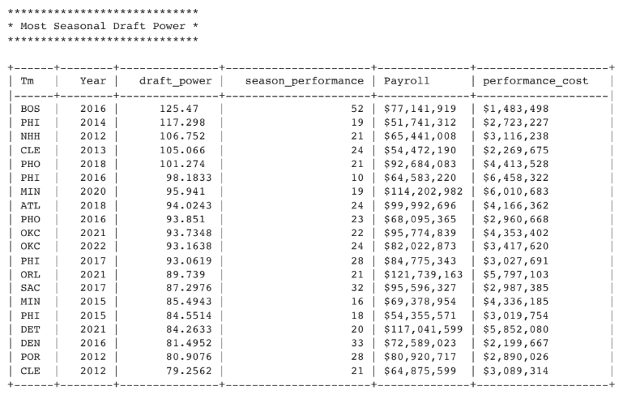
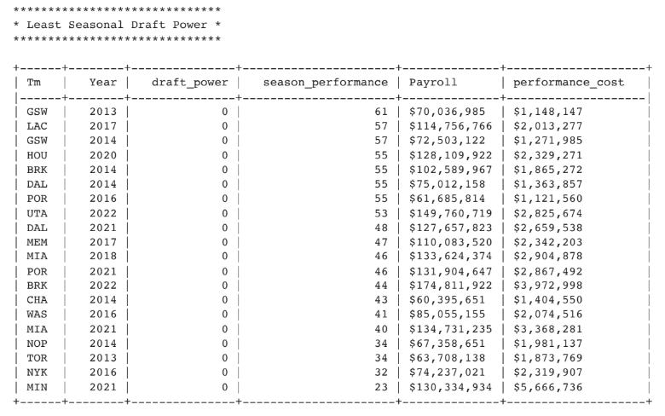

Tails of Variable #3: Draft Power
Most Seasonal Draft Power
Least Seasonal Draft Power
Teams that perform worse are usually allotted higher draft picks. This is shown with these tables: the teams with the Most Seasonal Draft Power tend to be either teams that missed the playoffs or those that have multiple picks. The teams with the Least Seasonal Draft Power are franchises that have no picks, likely due to trades involving their draft picks.
Interestingly, in the left column, the only team with great draft power who has made the playoffs are the 2015-16 Boston Celtics. This outlier may be due to the Celtics trading Paul Pierce and Kevin Garnett for Brooklyn’s future 1st Round Picks, a move which backfired on the Nets and allowed Boston to get top draft picks.

Slide 18
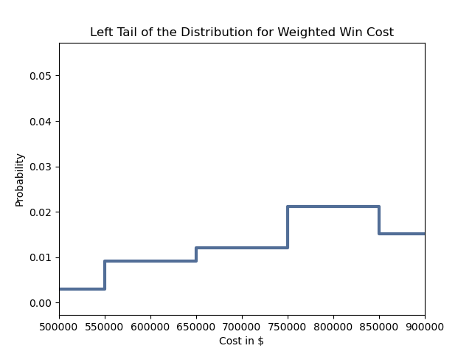
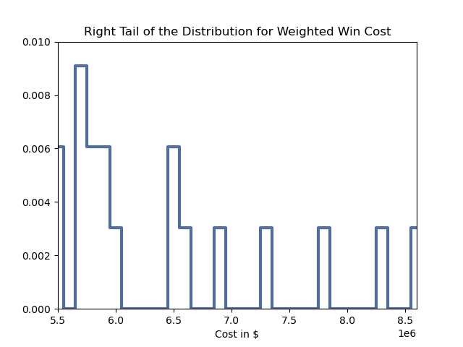
Tails of Variable #4: Weighted Win Cost
→ The left tail displays the teams that spend the least to get a weighted win.
→ The right tail displays the teams that spend the most. There are only a few records.

Slide 19
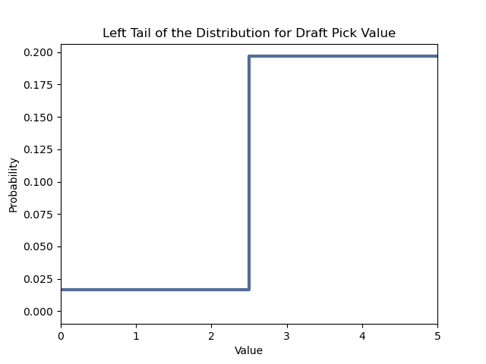
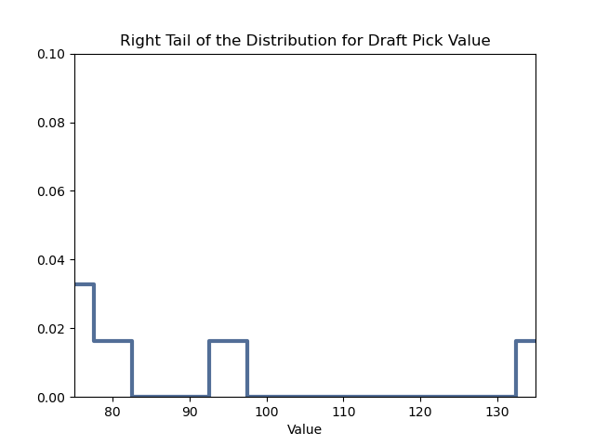

Tails of Variable #5: Draft Pick Value
→ The left tail displays the lowest median weighted win shares.
→ The right tail displays the highest median weighted win shares.

Slide 20
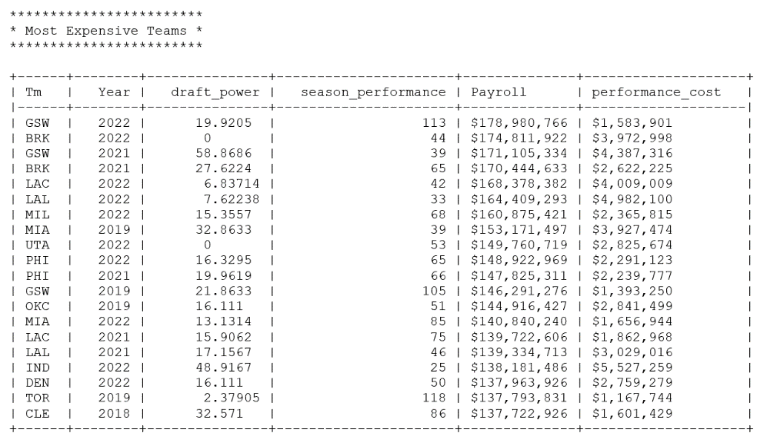
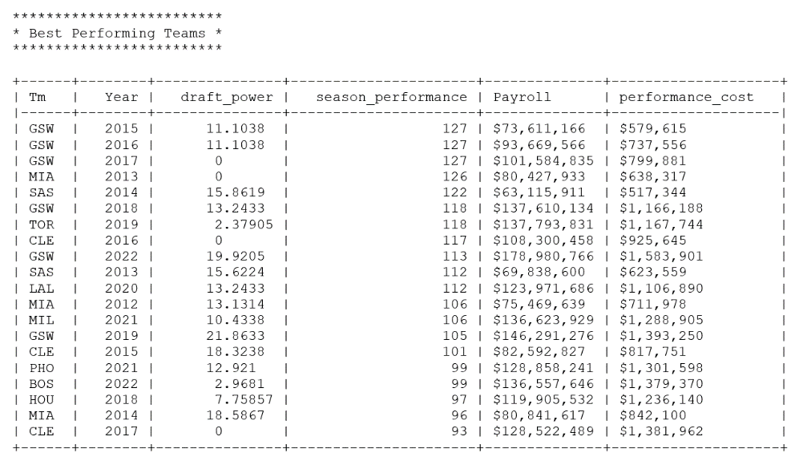
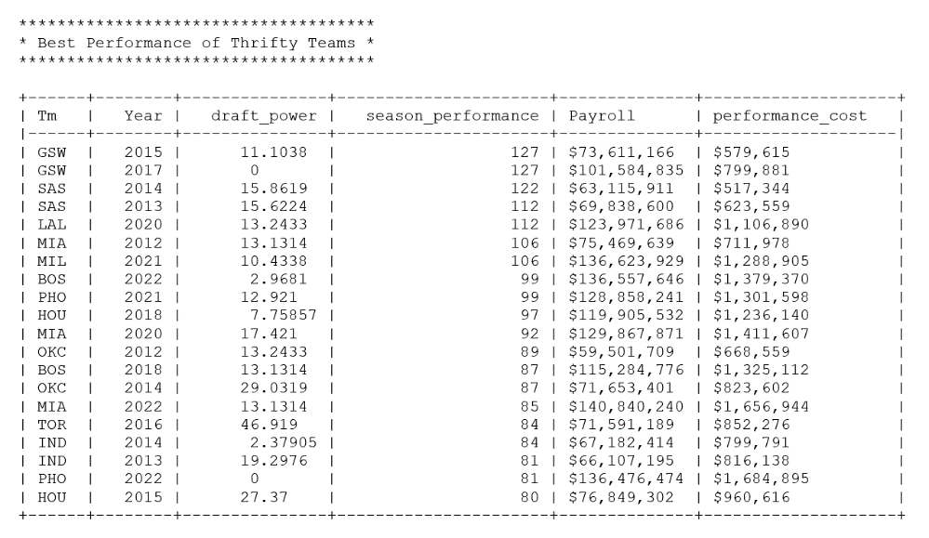
PMF to Determine Data
Most Expensive Teams
Best Performing Teams
Best Performing Thrifty Teams
We will exclude the 5 highest payrolls for every season to determine the front offices who were most successful with their seasons without spending the most money.

Slide 21
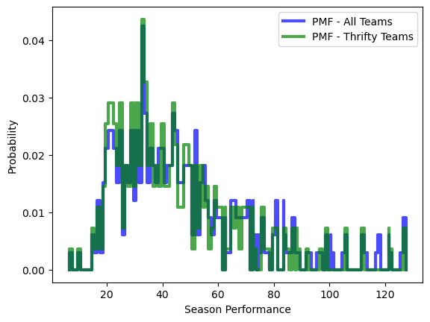

PMF to Determine Data – All Teams vs Thrifty Teams
While thrifty teams concentrate at the median season performance, there have been some with notable success.
https://www.google.com/url?sa=i&url=https%3A%2F%2Fwww.icegif.com%2Fbasketball-52%2F&psig=AOvVaw1KtpCIgPlJyg_O2ZeeUaFl&ust=1685840367980000&source=images&cd=vfe&ved=0CBEQjhxqGAoTCOips_Typf8CFQAAAAAdAAAAABCmAQ

Slide 22
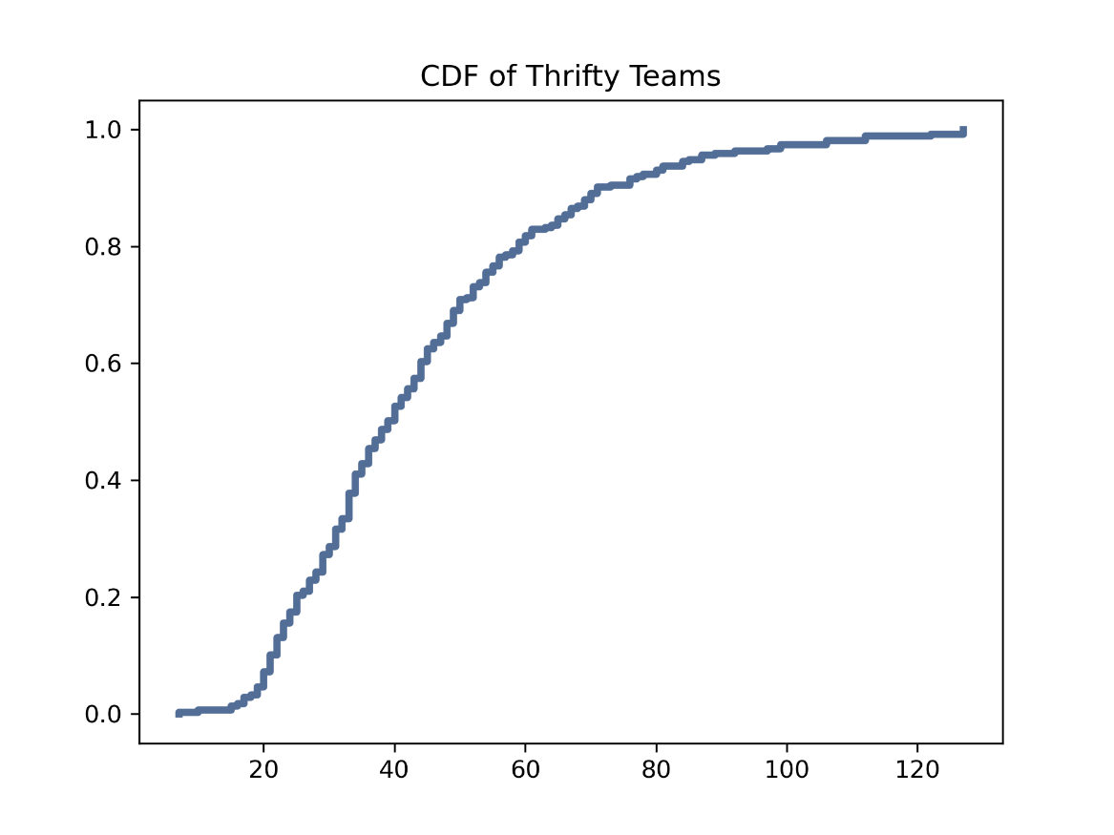
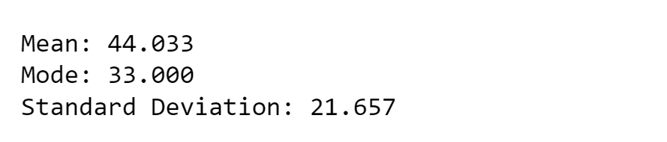
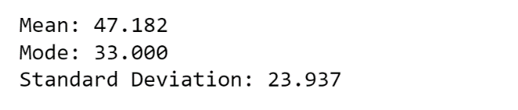
CDF to Determine Data
Since we already defined the CDFs for each of the 5 variables, we will look at one without the top 5 spenders.
Here are the variables of season performances by thrifty teams
Only 3 Wins
For comparison, here are the variables of all recent season performances

Slide 23
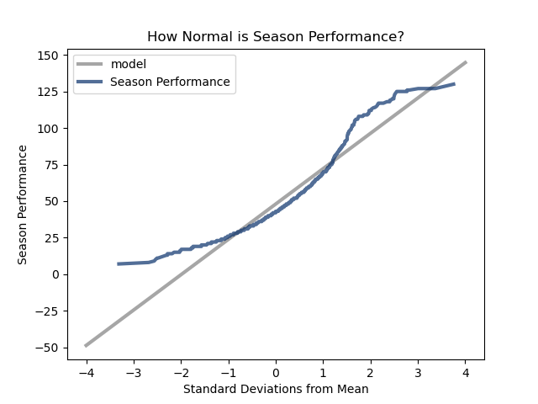

So… How Normal is Season Performance?
Not very normal!
In a standard normal distribution, approximately 68% of the data falls within one standard deviation of the mean, and approximately 95% falls within two standard deviations. The grey plotted line represents a normal distribution, whereas the observed data varies greatly from normal.

Slide 24

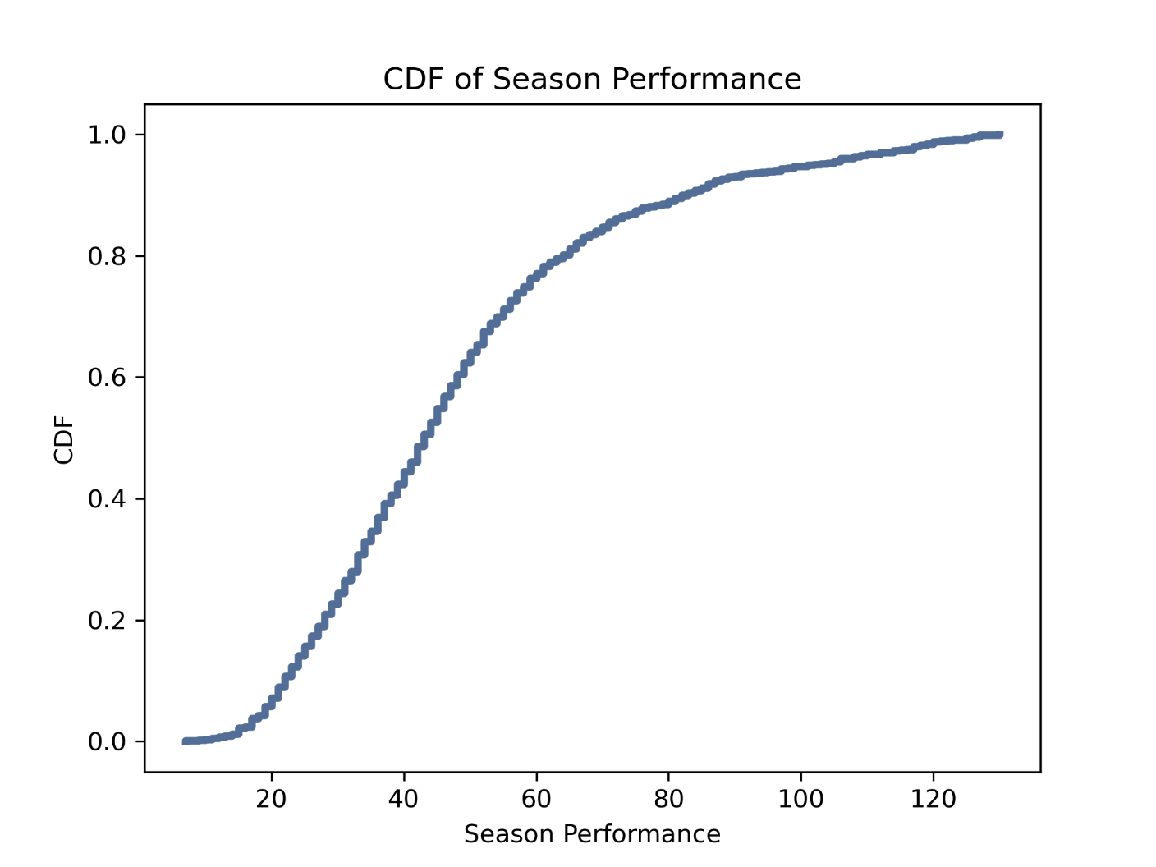
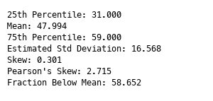
Season Performance Tail Skewing
Report of CDF of Season Performance

Slide 25
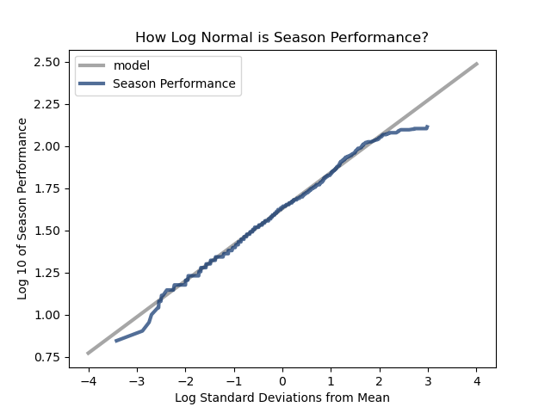
How Log Normal is Season Performance?
Quite normal.
The log of the season performance agrees with the normal model across almost 4 standard deviations from -2 to 2.

Slide 26
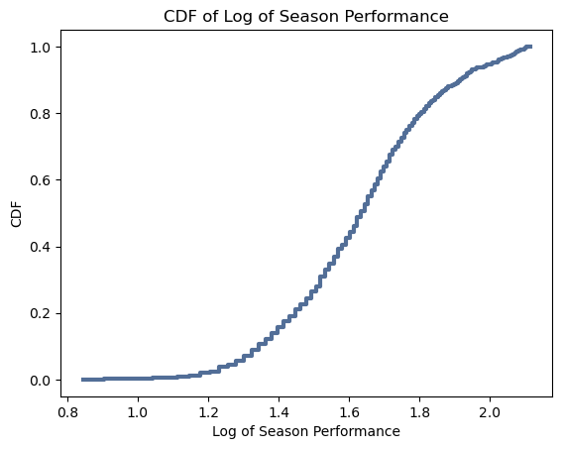
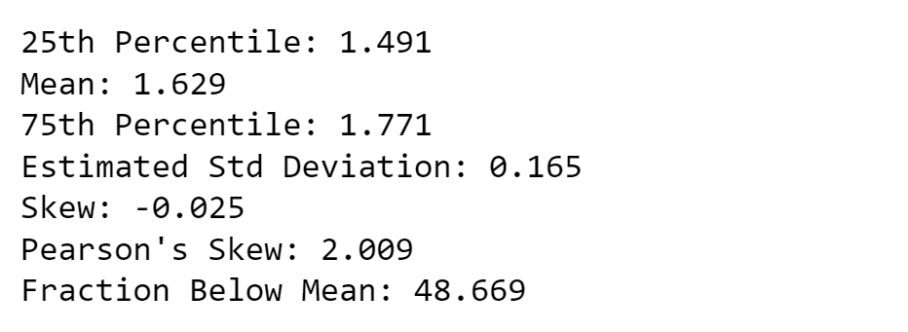
Log of Season Performance Statistics
Report of CDF of Log of Season Performance

Slide 27
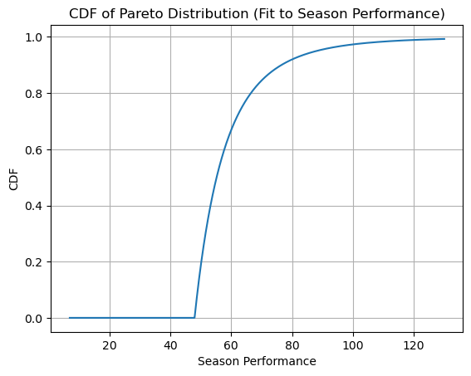
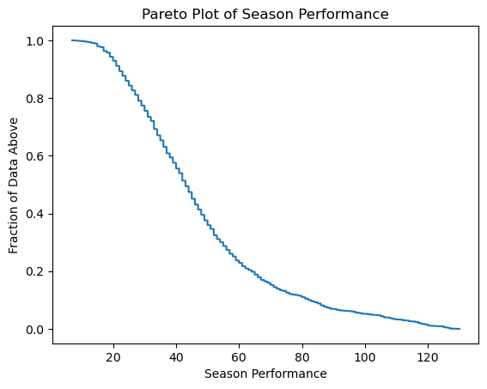
Pareto Distributions of Season Performance
→ This shows a CDF of Pareto Distribution.
→ Here is the Pareto plot.

Slide 28
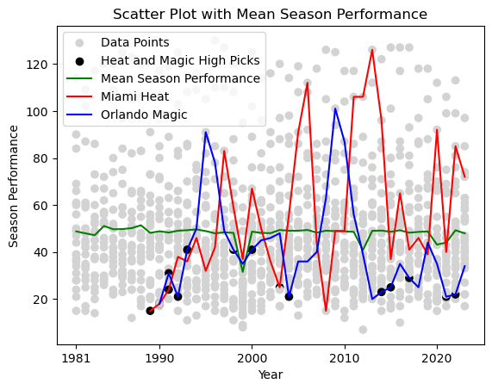


Scatter Plot With Mean Season Performance
Now, let us compare two franchises that are from the same state!
The Orlando Magic’s successful seasons follows the drafting of Shaquille O’Neal and later Dwight Howard. They benefited from many top draft picks, with mixed success.
The Miami Heat’s period in 2003 mirrors the drafting of Dwyane Wade. They are generally more competitive and attract top free agents like LeBron James and Jimmy Butler.

Slide 29
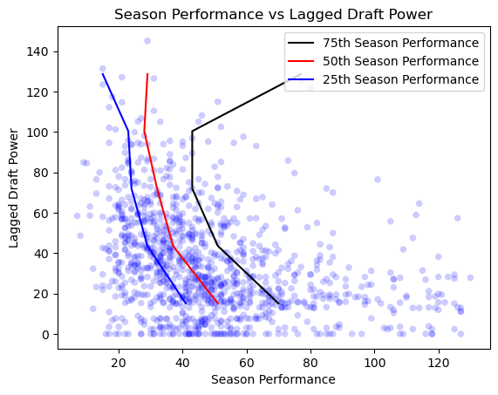

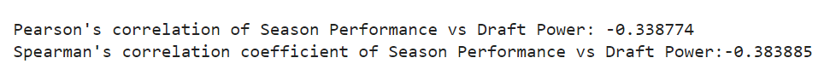
Correlation
To test the effectiveness of the draft I compared two variables: Draft Power and Season Performance. Draft Power is the sum of the median win shares of the team’s draft picks for the season.
The draft occurs at the end of the season, so I introduced a lag factor.
→ Known: Generally, teams with poor season performance are given earlier draft picks, and, therefore, higher Draft Power.
→ Expected: After teams have high draft power, their Season Performance will improve.
Correlation of Season Performance vs Draft Power
https://media2.giphy.com/media/0PMcrZcstFh8hJVOJf/giphy.gif?cid=6c09b952f68d7ff76103bcfb291ef8cef8fdf5cda66e80c1&ep=v1_internal_gifs_gifId&rid=giphy.gif&ct=s

Slide 30
Analysis of Correlation and Causation
A negative correlation suggests that as the Draft Power increases (median impact of players drafted), the Season Performance tends to decrease, however there are exceptions, especially when poor performing teams trade their picks to successful teams. It is clear that teams with higher draft power may not immediately achieve higher performance in the league. Note that this is expected because teams rarely have rapid improvements after drafting high. It takes time for players to find their place on a team and make an impact.
Correlation coefficients provide a measure of the linear relationship between two variables, but they do not imply causation. Other factors not considered in this analysis may influence Season Performance. These include team management, coaching, culture, player development, and overall team strategies.
Additionally, the strength of the correlation
(-0.3388 and -0.3839) suggests only a moderate relationship, not strong enough to make definitive conclusions.
Correlation of Season Performance vs Draft Power

Slide 31
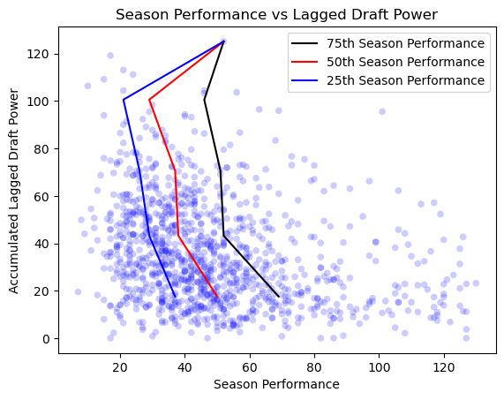


Adding a Second Season of Lagging
To account for team fit I added a second season to the equation and used a weighted mean to emphasize the draft two seasons earlier.
Similar to the previous graph, the strength of the correlation (-0.2781 and -0.3099) suggests that there is not enough data to make conclusions.
Correlation of Season Performance vs Draft Power
https://media.tenor.com/dOUt3iLu4P8AAAAj/sports-sports-manias.gif

Slide 32
Hypothesis Test - "Player Impact ~ Years of Service + Draft Rank"
* Null hypothesis (H₀): There is no significant relationship between years of service and draft rank on win shares.
* Alternative hypothesis (H₁): There is a significant relationship between years of service and draft rank on win shares.
* Multivariate OLS Regression Analysis:
Endogenous: “Weighted Win shares“
Exogenous: “Draft Rank” and “Years of Service".
"Years of Service" is exponentially subtractive after age 30 to indicate player is past their prime.
The logarithm of rank is used because rank as a linear relationship proved a poor predictor.
* Result
I reject the Null Hypothesis but with a caveat.
Even though the p-values of the independent variables indicate statistical significance, their coefficients are small.
R-squared value indicates these variables explain only 11.3% of the variation in player winning impact.
F-test indicates the model is significant.
Draft rank coefficient is negative (as expected). Years of service has a positive coefficient. Neither has dramatic impact.
Durbin-Watson statistic (0.679) indicates positive autocorrelation in the residuals, suggesting underlying patterns or relationships not captured by the model.
Overall, the model suggests that while both Rank and Years of Service have statistically significant effects on "Impact", they only explain a small proportion of the total variability.

Slide 33


Hypothesis Test: Model Results
Note: Only drafted players can be evaluated
https://media.tenor.com/dlY3bekU9BsAAAAj/sports-sportsmanias.gif

Slide 34
Interpretation
→ R-squared: The R-squared value of 0.114 indicates that approximately 11.4% of the variability in the "Impact" variable can be explained by the predictors (Rank and Modified Years of Service). In other words, the model does not explain a large portion of the variation in the dependent variable.
→ Coefficients: The coefficients represent the estimated effect of each predictor on the "Impact" variable. Log rank is negative, which is expected. That is, as the draft rank increases, fewer win shares in playoffs and regular season are expected. Years of service is generally positive, which is also expected. This value is lower than my estimation.
→ Intercept: The intercept is excluded because it is not relevant. Neither Rank = 0 or Years of Service = 0 makes sense in the model.
→ Log Rank: The coefficient for Log Rank (-1.3541) suggests that, on average, each unit increase in Rank is associated with a decrease of -1.3541 in the Impact. In other words, an increase in log rank of 1, meaning an increase in 10 of rank, diminishes win shares by only -1.3541.
→ Modified Years of Service: The coefficient for Modified Years of Service (0.1923) indicates that, on average, each additional unit of Modified Years of Service is associated with an increase of 0.1923 in the Impact.
→ p-values: The p-values associated with each coefficient indicate the statistical significance of the corresponding predictor. In this case, all predictors (Rank and Modified Years of Service) have p-values less than 0.05. They are statistically significant for the model of Impact.
→ The Durbin-Watson statistic (0.679) tests for residual autocorrelation. It indicates positive autocorrelation in the residuals. There is a tendency for the residuals to be positively correlated with each other, suggesting some underlying pattern or relationship in the data that is not captured by the model.
→ Overall, the model suggests that while both Rank and Modified Years of Service have statistically significant effect on "Impact", they only explain a small proportion of the total variability.
https://www.google.com/url?sa=i&url=https%3A%2F%2Fgifer.com%2Fen%2Fgifs%2Fanalysis&psig=AOvVaw01RIyUrkqDFifr7kfGrdJt&ust=1685858683021000&source=images&cd=vfe&ved=0CBAQjRxqFwoTCMDwt5G3pv8CFQAAAAAdAAAAABAE

Slide 35

Conclusion
Null Hypothesis is False But Model is Inconclusive
Possible Explanation
One reason draft rank may be a poor predictor is that drafted players (sometimes teenagers on Draft Day) often fail to live up to their potential. In fact, the NBA is populated with players drafted early in the first round who disappointed and late drafted or even undrafted players who have at least the same impact on winning.
This is clear from the graphs on the next slide.
https://media3.giphy.com/media/WtPRmrVDNhL7cAHQKR/giphy.gif?cid=6c09b952fv6jy1hss2ljlstfawinwo9naxt81ds4qfghulmu&ep=v1_stickers_related&rid=giphy.gif&ct=s

Slide 36


How Well Can Draft Rank Predict a Player’s Future?
Not very well.
While the median of drafted players is a gentle sloping curve, there are many outliers, including some players who have nearly 200 weighted win shares who are drafted after 50. It is clear that late drafted players can sometimes have very impactful careers in the NBA. Note also the column left of 1 for undrafted players who have also contributed to franchise success.
https://cdn.dribbble.com/users/887239/screenshots/14103720/media/5982452dbce535db6d474f560799a678.gif

Slide 37


Conclusion
These graphs also consider players drafted who never played in the NBA. It is even clearer in the zoomed fitted line graph that the median impact of a draft pick diminishes very quickly, a fact that motivates some teams to tank to get an early pick. Not even first picks are guaranteed to be beneficial, however, and good players are found throughout the draft. Draft pick rank explains only 11% of their success.

Slide 38

Thank You!
https://www.google.com/url?sa=i&url=https%3A%2F%2Fwww.gifservice.fr%2Fen%2Fgif%2Fsports-basketball-usa-nba-miami-heat-g32.php&psig=AOvVaw19cIIlOSYyuu1y42ycfgyn&ust=1685841612394000&source=images&cd=vfe&ved=0CBEQjhxqFwoTCLjk28X3pf8CFQAAAAAdAAAAABAR

